Slide 1


Slide 2
PRESENTATION AGENDA
COMPANY INTRODUCTION
OBJECTIVES
TARGET AUDIENCE
GENZ+MILLENNIALS BEHAVIOR (SEARCH, DIGITAL, CATEGORY)
KEY TAKEWAYS
CONCEPT IDEAS
PROMOTIONAL STRATEGY: PESO IN DETAIL
ROLL OUT TIME PLAN

Slide 3
WAYFAIR: IN ESSENCE
ABOUT THE BRAND
Wayfair is America’s leading home furnishing brand catering all the home décor needs of the customers.
MARKET VALUE CONTEXT
Home décor market value is growing in the country YOY. In 2021 the market value was 181 billion dollar and In 2022 it is forecasted to increase to 189 billion dollars
Wayfair is the legacy player holding the market share of 33.4% in 2019 but the competition is giving a cut throat competition in home-furnishing category.
PRODUCT AND USP
-The seamless customer experience to seep into an in-store experience from product picking to delivering.
- No compromise on the product quality that makes the brand stand out from other competitors
OPPORTUNITY
Post-Covid normalization for our audiences will see them return to familiar activity with an enhanced sense of online shopping behavior
Digital influence of the audiences offers high potential for Wayfair to be able to crack through existing barriers and build relevance

Slide 4
OBJECTIVES: SOLVING BRAND PROBLEMS
Specific
Building brand awareness among potential customers targeting 21 - 35 years old people, currently neglected
Measurable
The paid campaigns can be analyzed and the YOY comparison can be compared to check the numbers of CPA, ROI, ROAS, etc.
Achievable
The goal can be easily achieved if the strategy is built with proper amalgamation of customer needs and product requirements
Relevant
Timely
The goal will help in achieving the overall success metric and revenue of Wayfair which can expand the horizon to target new avenues and markets
SMART GOAL
Retain and engage with the users to avoid brand switching with spot on personalization from owned assets
The entire marketing campaign will start from July, so the last week of June is the due date to complete planning, strategizing, execution and monitoring the framework and requirements
A full fledged marketing strategy from top to bottom of the sales funnel driving the success metric of gaining profitability with the mutual effort of all the marketing + technology team to make Wayfair expand its horizon globally and achieve overall success in driving users.

Slide 5

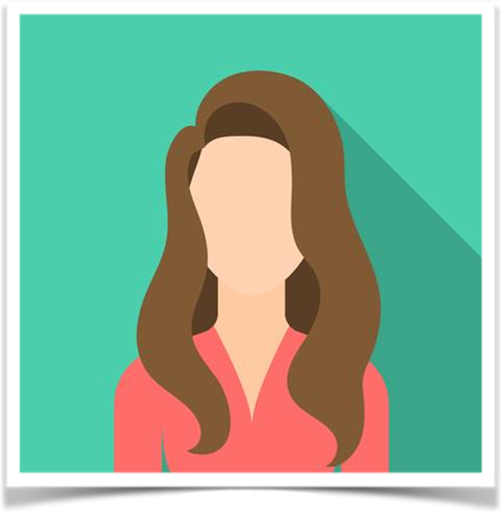

OUR USERS: WHO ARE WE TALKING TO?
Our Audience: Tap 21 – 35 years old Age Group (Mix of GenZ and Millennials as Initiators), 36-55 years old as the usual audience targeted. SEC A and B
Region: USA
GenZ
Young and Free Spirit
Initial Stage of Career
Love Pursuing Hobbies
Dating and Parties
Social Media and Entertainment
Affordable Buying Approach
Millennials
Career Oriented
Experimental Approach
Mid Level Career
Prefer Online Shopping
Loves Vacation and Hangout with family and friends
Own Car, Planning to buy home/Apartment
Free-Spirit
GenY
This is a broad Spectrum: From Homemakers to successful execs
Travel World
Vacation/Business Trips
Online+Offline Shopping
Owns single multiple properties/Cars
Kitty Parties, Business Meetings

Slide 6
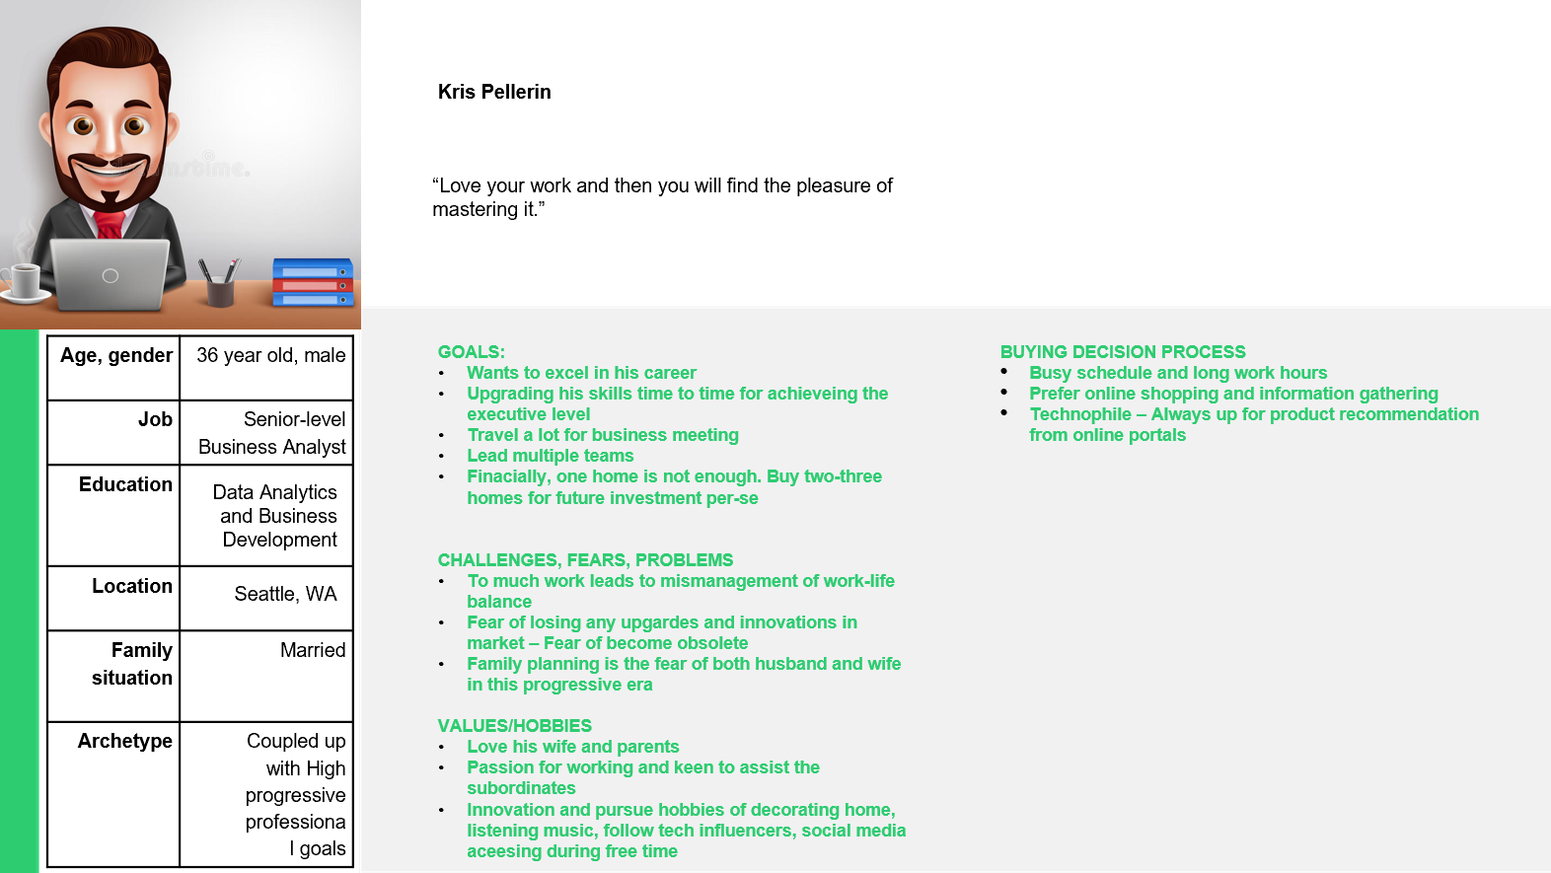
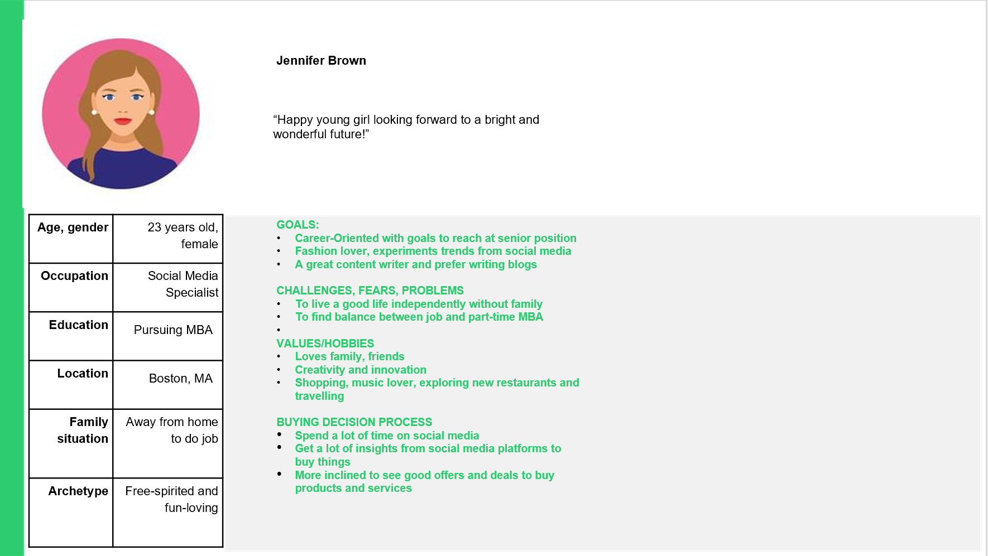
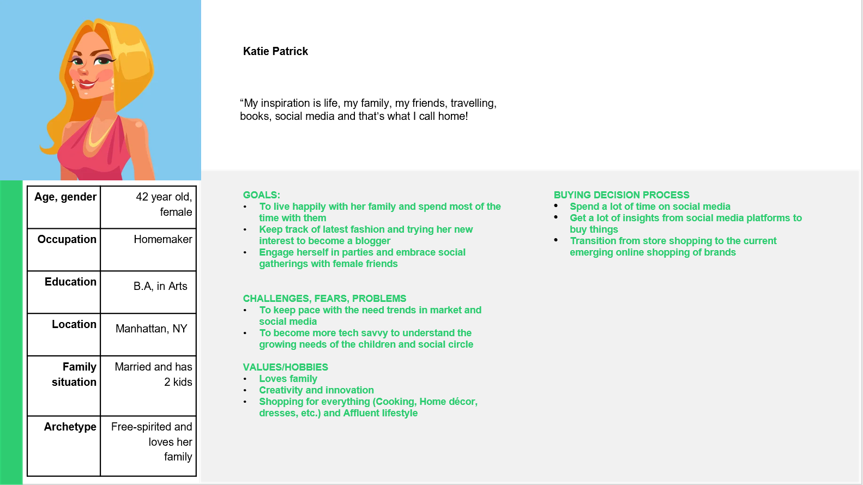
BUYER PERSONA

Slide 7
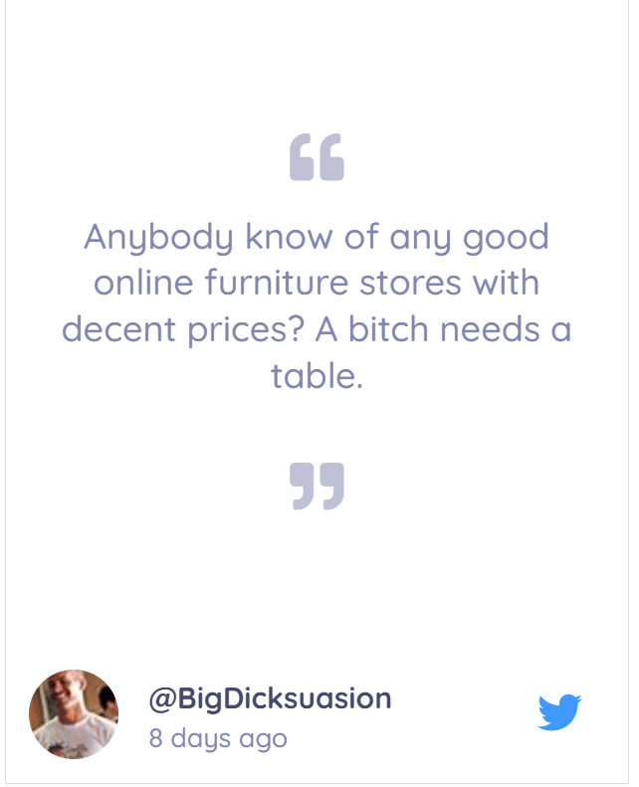
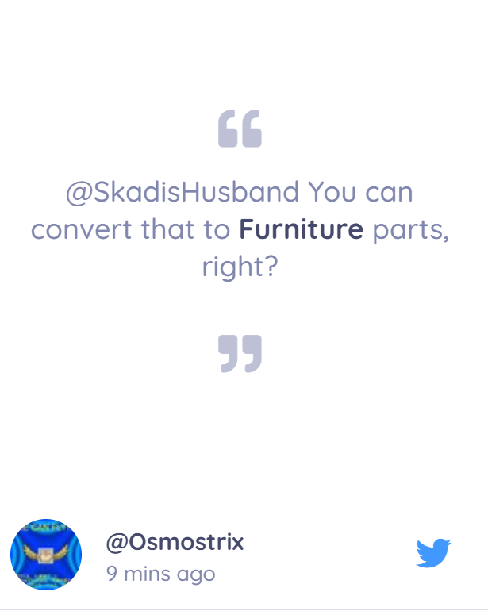
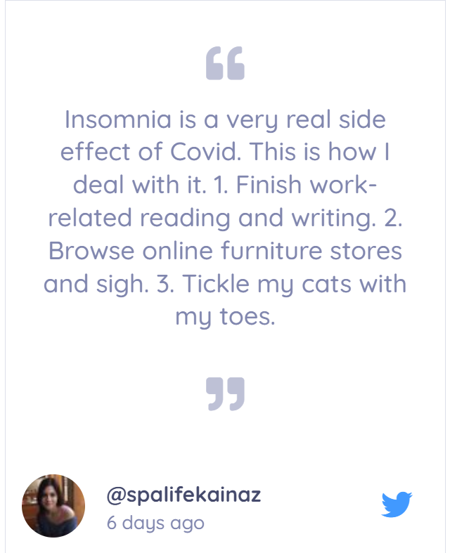
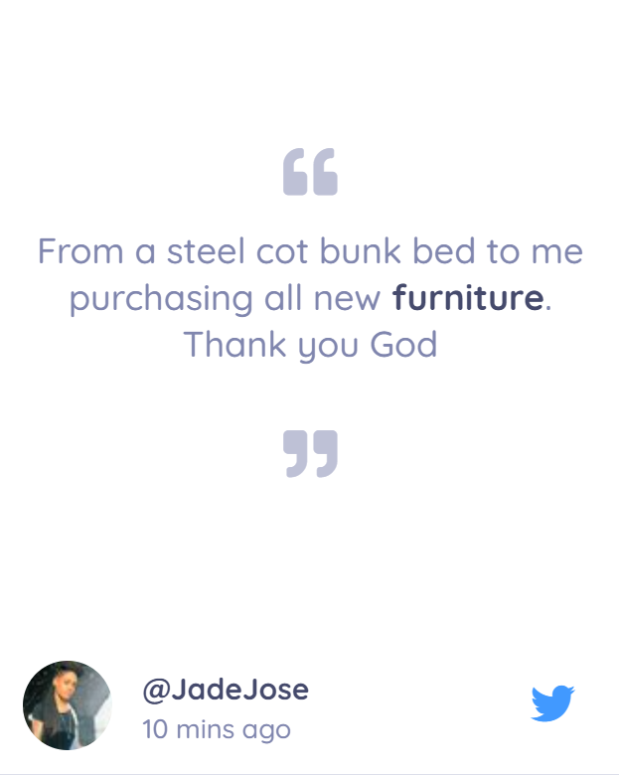
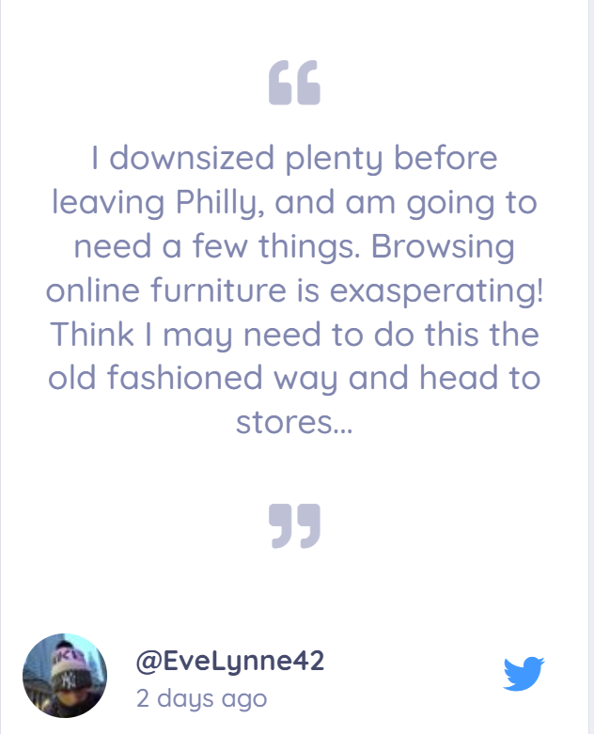
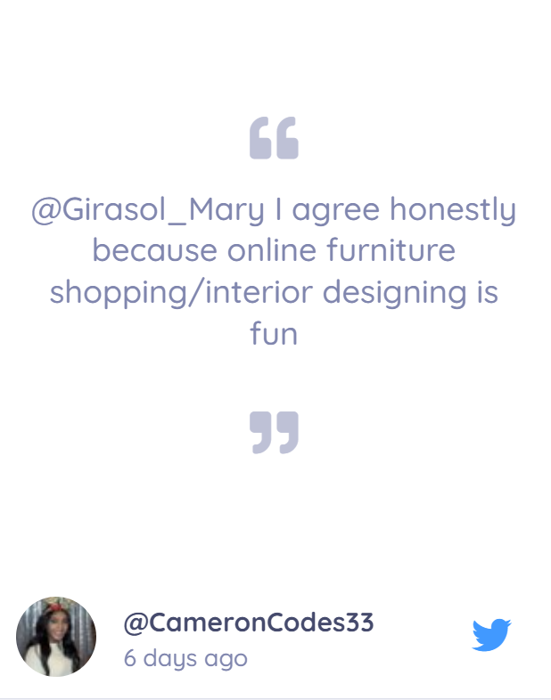
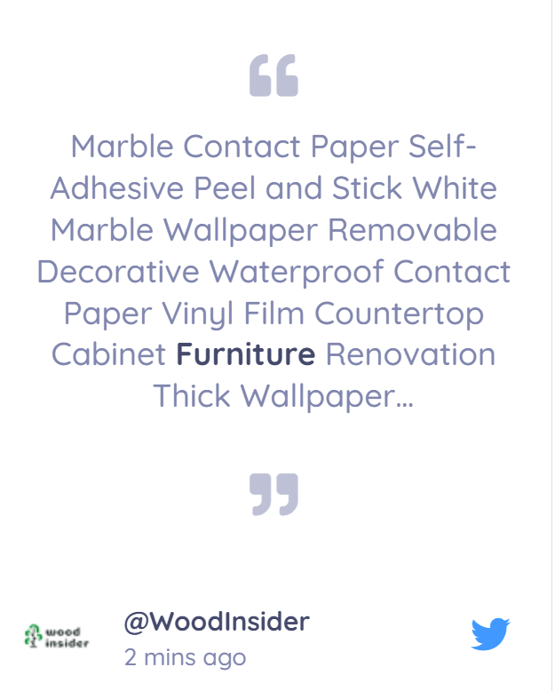
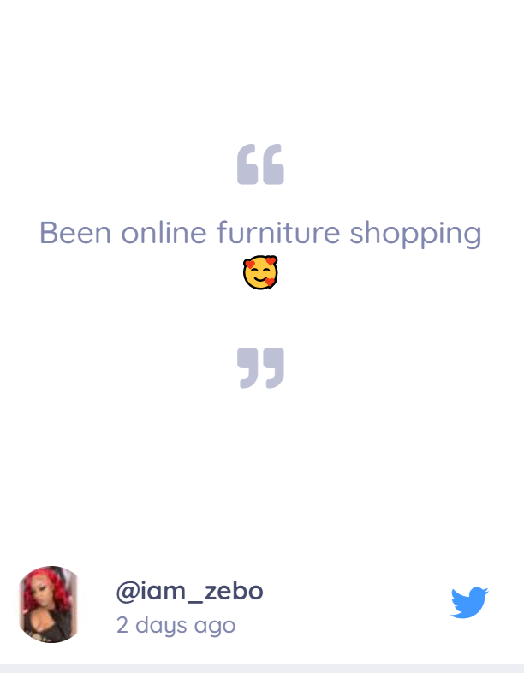
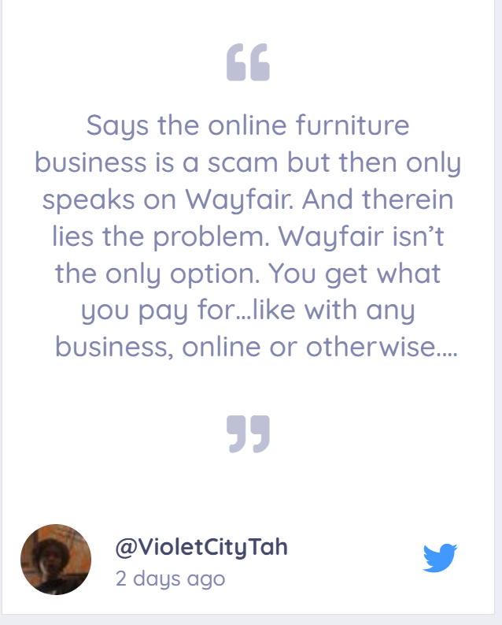
AUDIENCE BEHAVIOR: HOME DÉCOR CATEGORY OUTLOOK (Behavior of GenZ+Millenials)

Slide 8
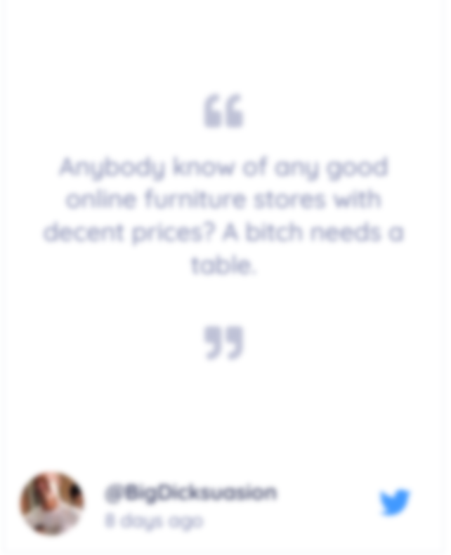
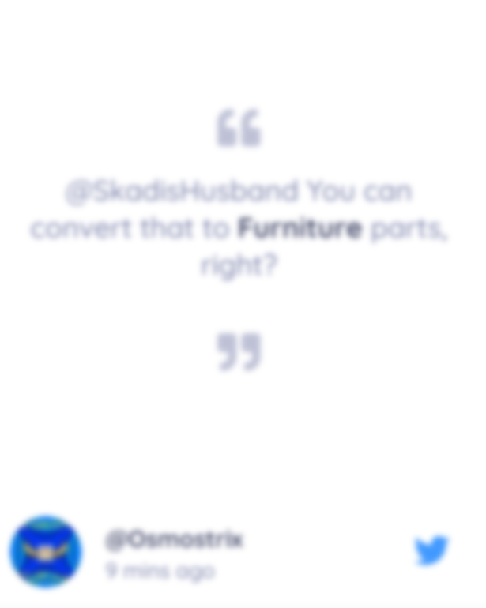
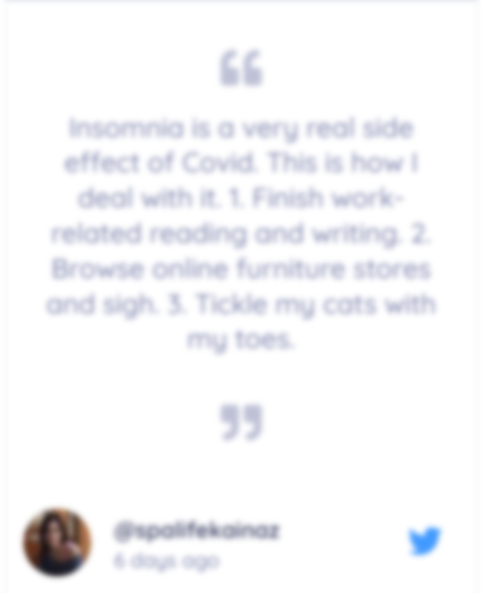

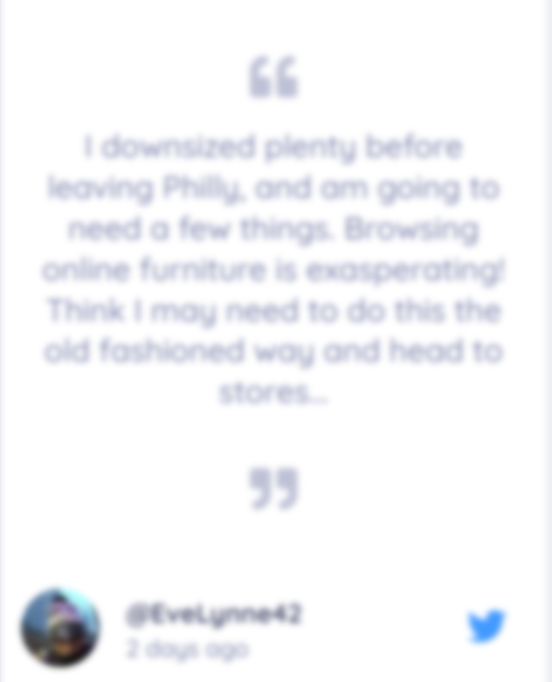

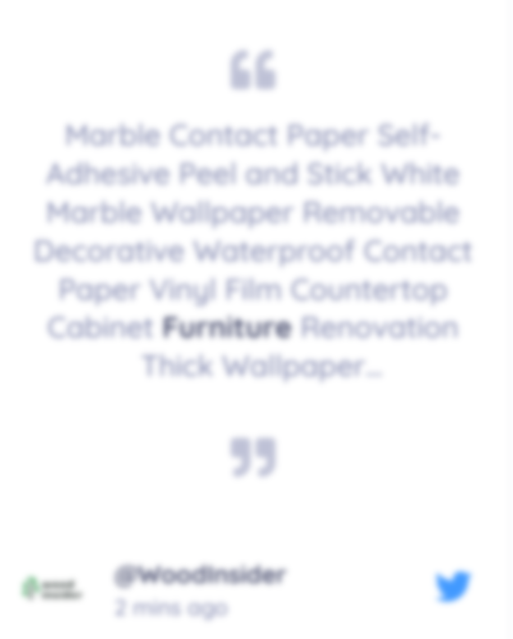
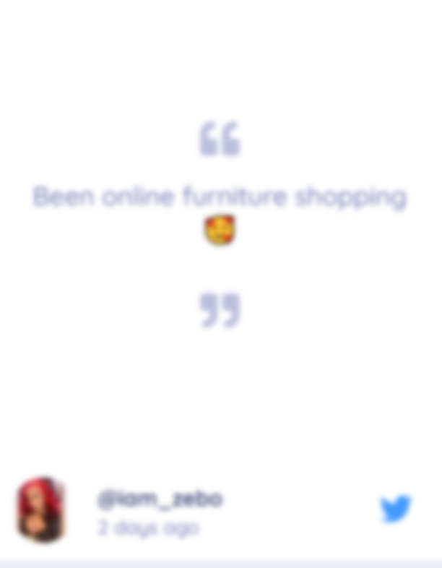

AUDIENCE BEHAVIOR: HOME DÉCOR CATEGORY OUTLOOK (Behavior of GenZ+Millenials)
Classy
Delivery
Modern
Distinctive
Affordable
Elegant
ecommerce
Sleek
Space
Not Bulky
DIY

Slide 9
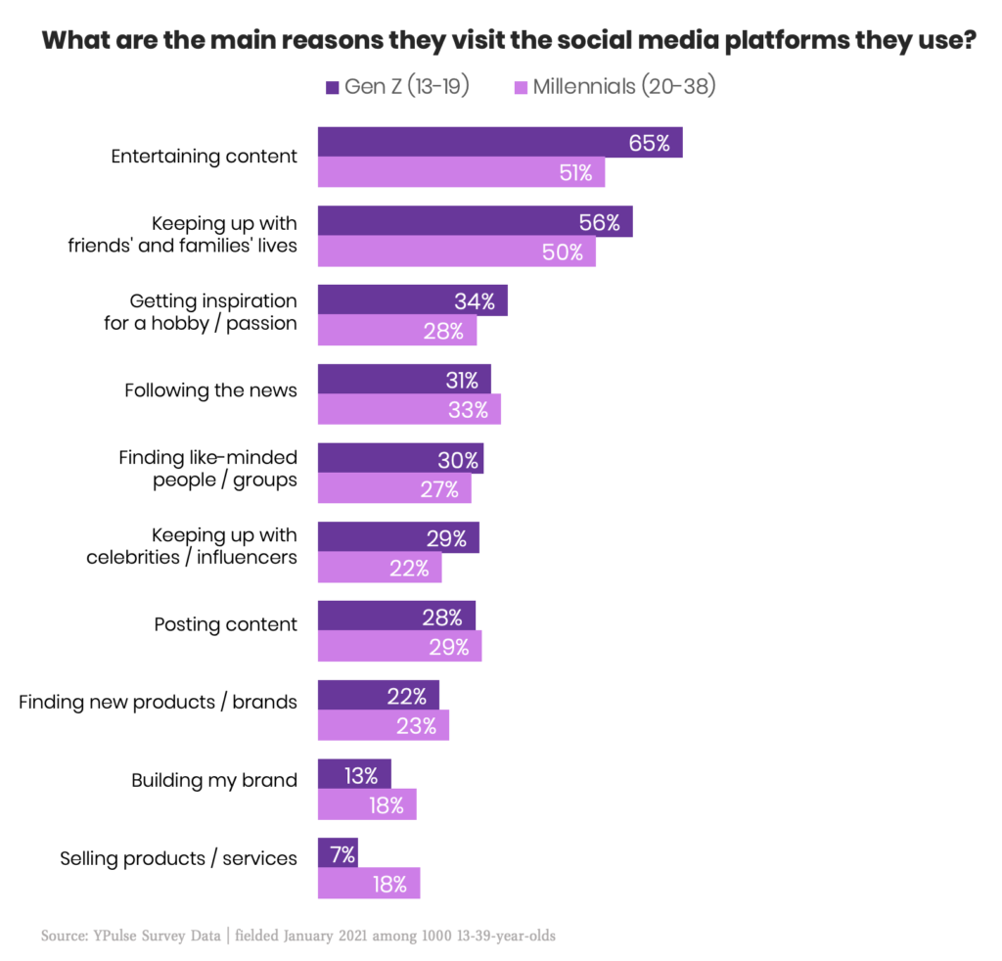
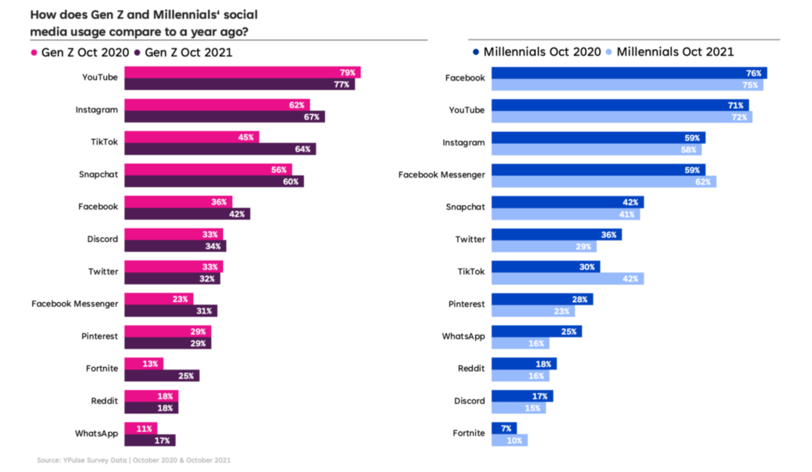
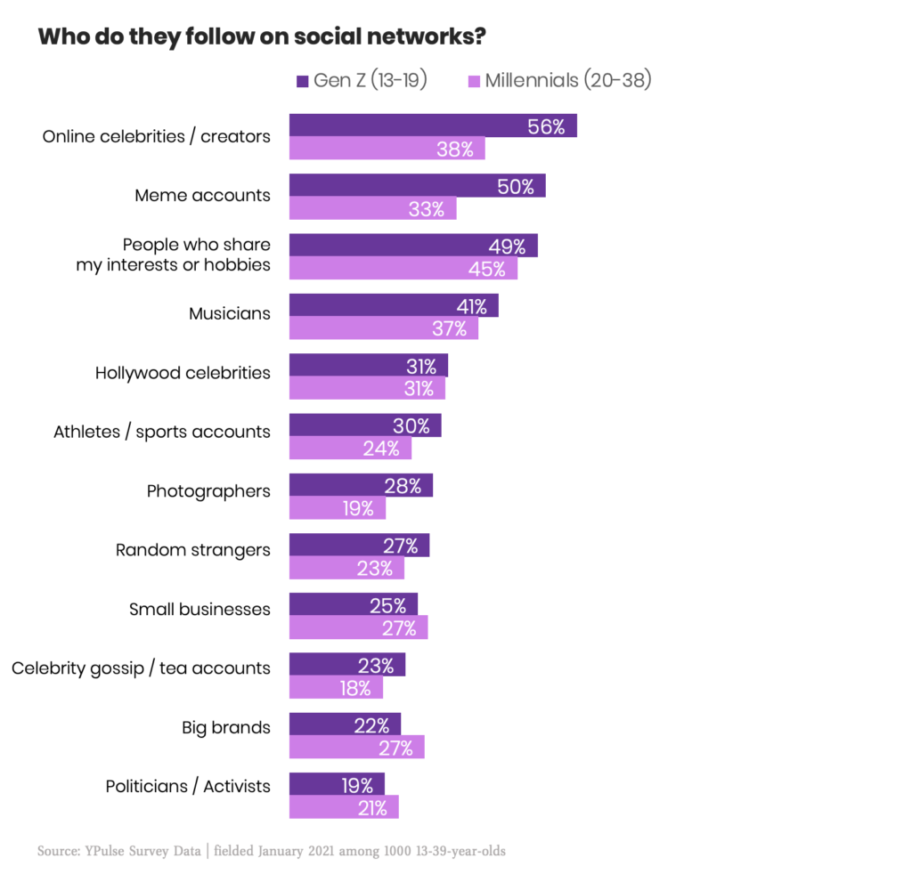
Digital Consumption Behavior of Millennials and GenZ
Both GenZ and Millennials prefer social media as a tool for entertainment, getting inspiration for a hobby, connecting with people. GenZ mostly show inclination towards discovering new brands/products while Millennials prefer selling and building themselves as brands too
Millennials prefer Facebook over other platforms while GenZ are more inclined towards video and visual platforms
GenZ follow more celebrities/creators, memes while Millennials are more keen in following people who marry with their hobbies and interests, musicians and content creators

Slide 10
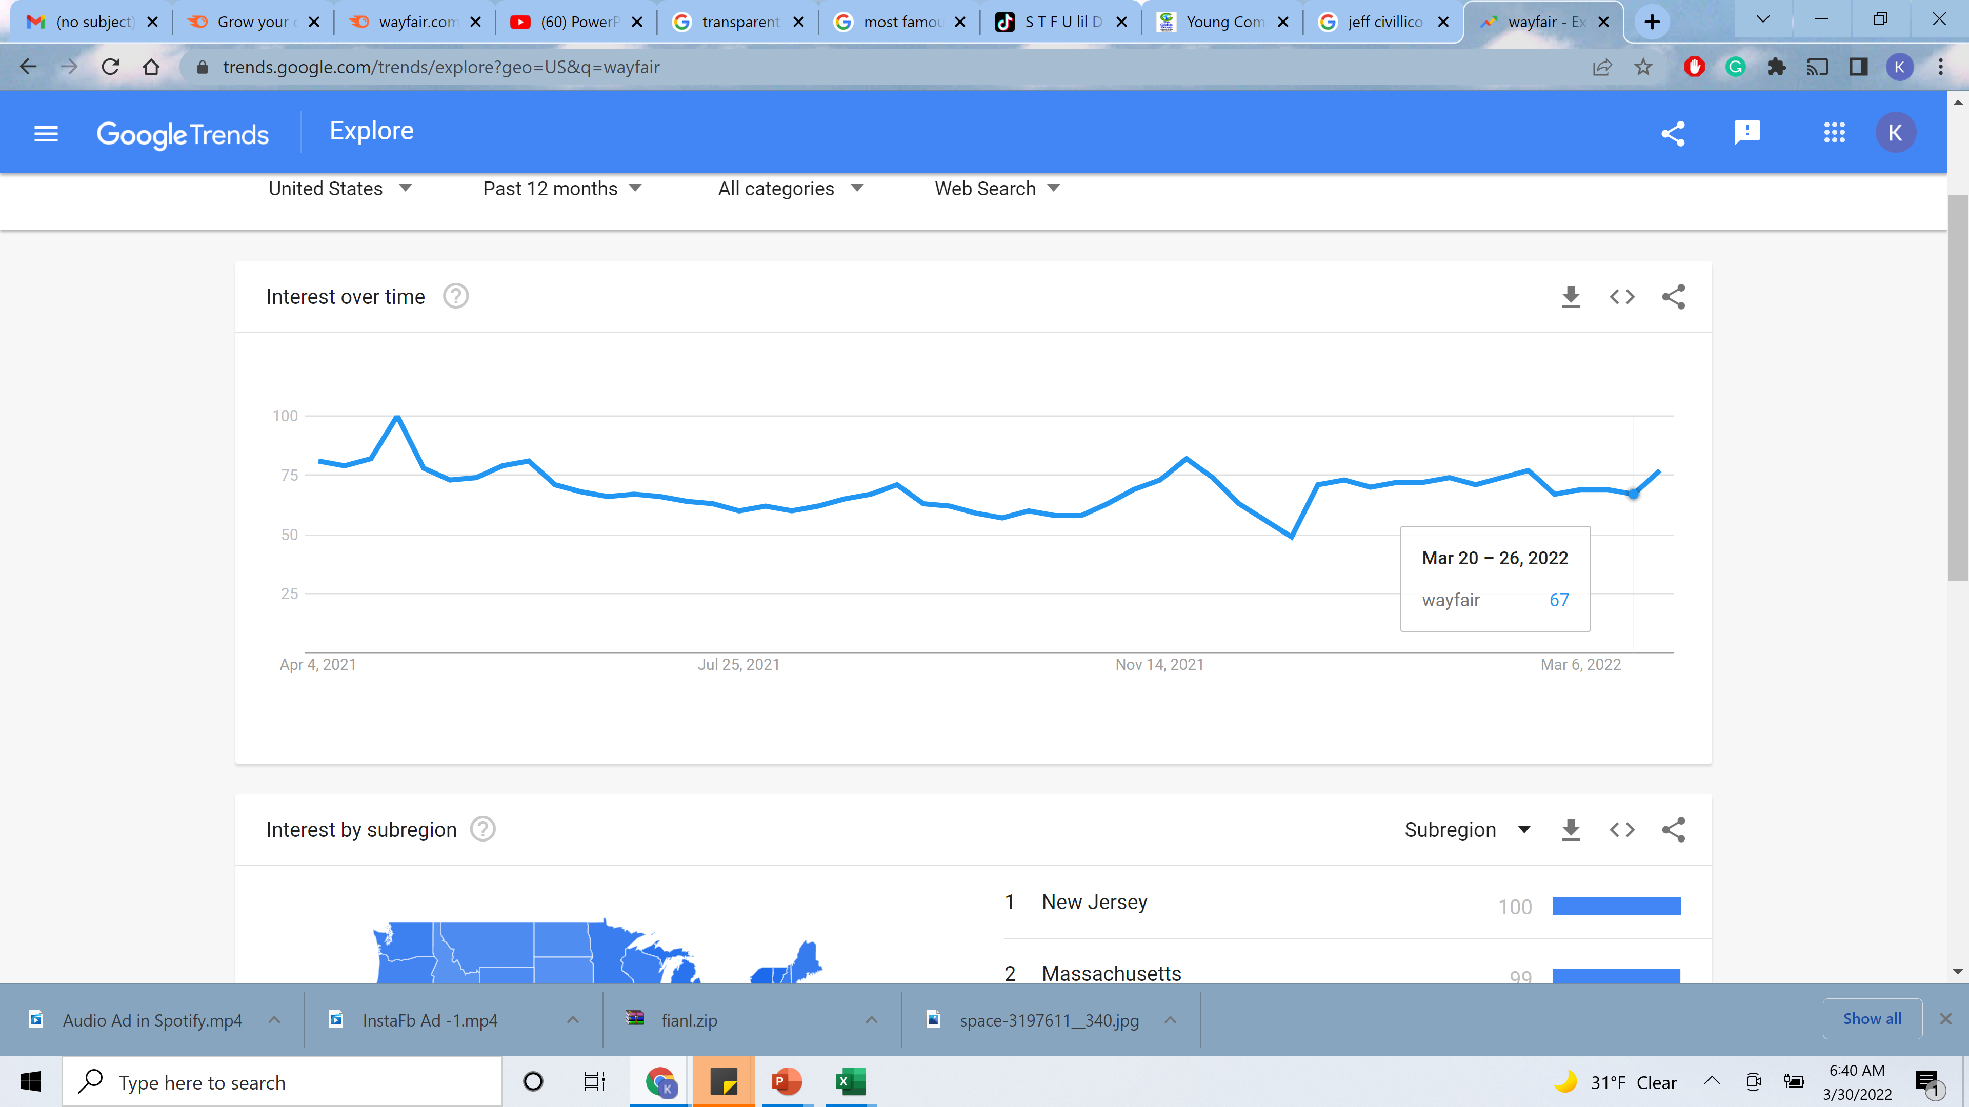
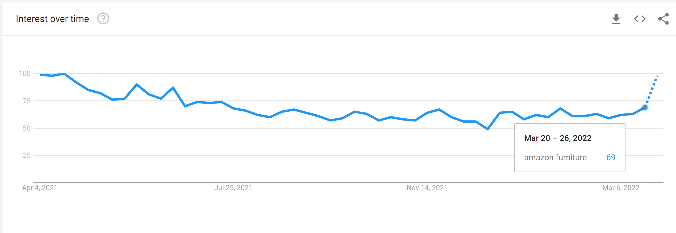
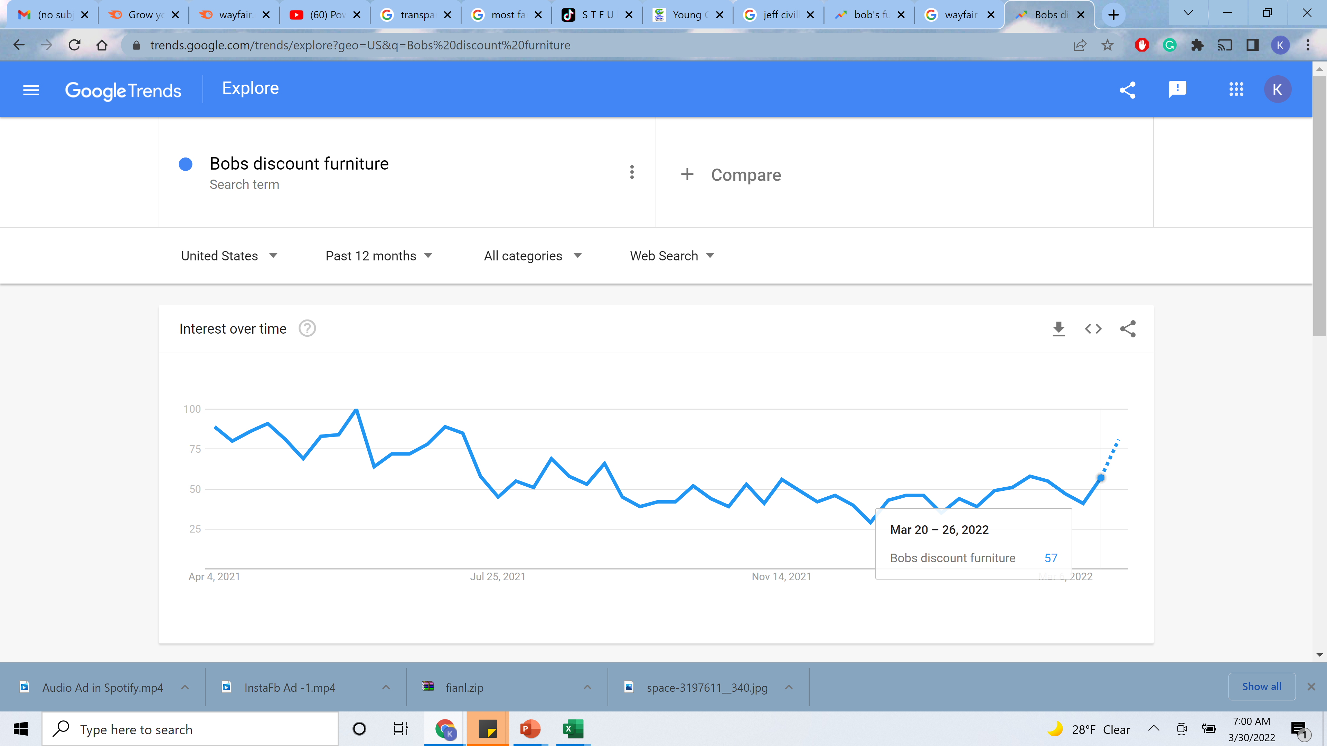
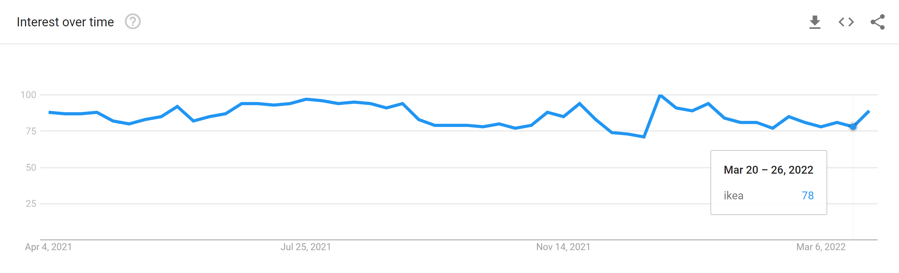
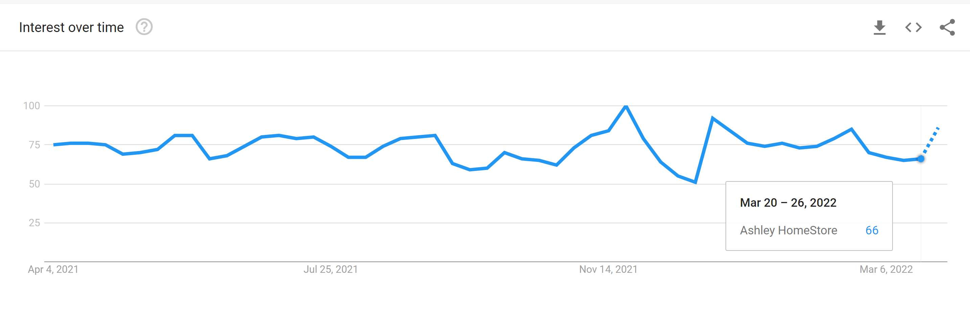

SEARCH PATTERN FOR HOME FURNISHING BRANDS
Wayfair
Amazon Furniture
Interest over time: Numbers represent search interest relative to the highest point on the chart for the given region and time. A value of 100 is the peak popularity for the term. A value of 50 means that the term is half as popular. A score of 0 means there was not enough data for this term.
- All the brands are competing with each other. Wayfair is moderately searched and the popularity is lower than IKEA, amazon and Raymour & Flanigan
Bobs Discount Furniture
Ikea
Ashley
Raymour & Flanigan

Slide 11
TAKEAWAYS: THE COMPLETE PICTURE
STRATEGIC LEARNINGS
1
2
3
ATTITUDE
CATEGORY SEARCH TREND
DIGITAL BEHAVIOR
GenZ+Millenials: Outgoing, exploring, experimenting with new things and take their appearances seriously.
Music, fashion and entertainment are their lifelines to refresh them.
Heavy digital influence across consumer persona
Their interest is shifting from store buying to online home furnishing
Particular about purchasing sleek, trendy, modern yet affordable furniture
Spacious home and avoid stuffing their work/home with unnecessary clutter
GenZ follow more celebrities/creators, memes, music while Millennials are more keen in following people who marry with their hobbies and interests, musicians and content creators
Both prefer humorous and relatable content
Discovery of brands/products through social media, consideration through reviews and finally convert via social media and internet
Both prefer the concept of videos as they showed interest in Instagram, TikTok (GenZ’s preference) while Millennials are more inclined towards YouTube and Facebook

Slide 12

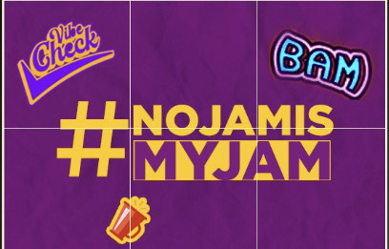
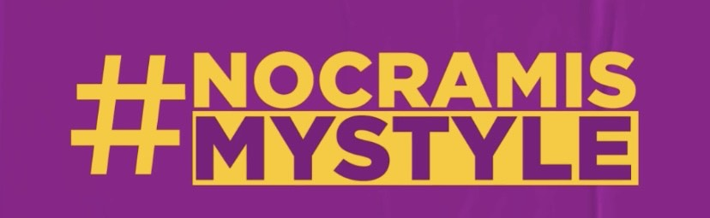
Main Concept to acquire GenZ+Millennials
Issue Setting
+
=
New Users
RTB
As per the understanding – Users need A-class premium and classy home décor as per their vibes. They prefer spacious areas, no clutter and no bulky stuff. Wayfair can be the one stop destination for all their needs.

Slide 13
PROMOTIONAL STRATEGY
PAID
Instagram Ads
EARNED
Influencer Marketing
Event – Stand-Up Comedy Shows
SHARED
Insta Posts
Instagram Stories
OWNED
Facebook Ads
Experiential Events
Bumble Wayfair Tie-Up
Email Marketing
Push Notifications
SEM
Spotify Ads
SMS Marketing
Videos and Content Marketing

Slide 14

Instagram and Facebook Ads - Paid
Please press play to view the ad
Objective: Brand Awareness
Zillennials and Millennials love watching fashion, food and lifestyle videos. We target them interestingly by putting contextual Facebook and Instagram ads before famous zillennial and Millennials videos. In this way, we bring out the concept #NOJAMISMYJAM and #NOCRAMISMYSTYLE
Concept: Issue Setting – i.e. hate bulky and heavy furniture and suddenly the savior has come. Wayfair is one-stop destination for elegant, classy furniture to meet the home décor expectations and stylish vibes

Slide 15

Instagram and Facebook Ads - Paid
Please press play to view the ad
Objective: Consideration Phase
GenZ and Millennials love watching fashion, food and lifestyle videos. We target them interestingly by putting contextual Facebook and Instagram ads before famous zillennial and Milennials videos. In this way, we bring out the concept #NOJAMISMYJAM and #NOCRAMISMYSTYLE
Value Proposition: As we know this segment prefer sleek, stylish décor as per their personality, hence portraying Wayfair for their RTB (Reasons to believe)

Slide 16
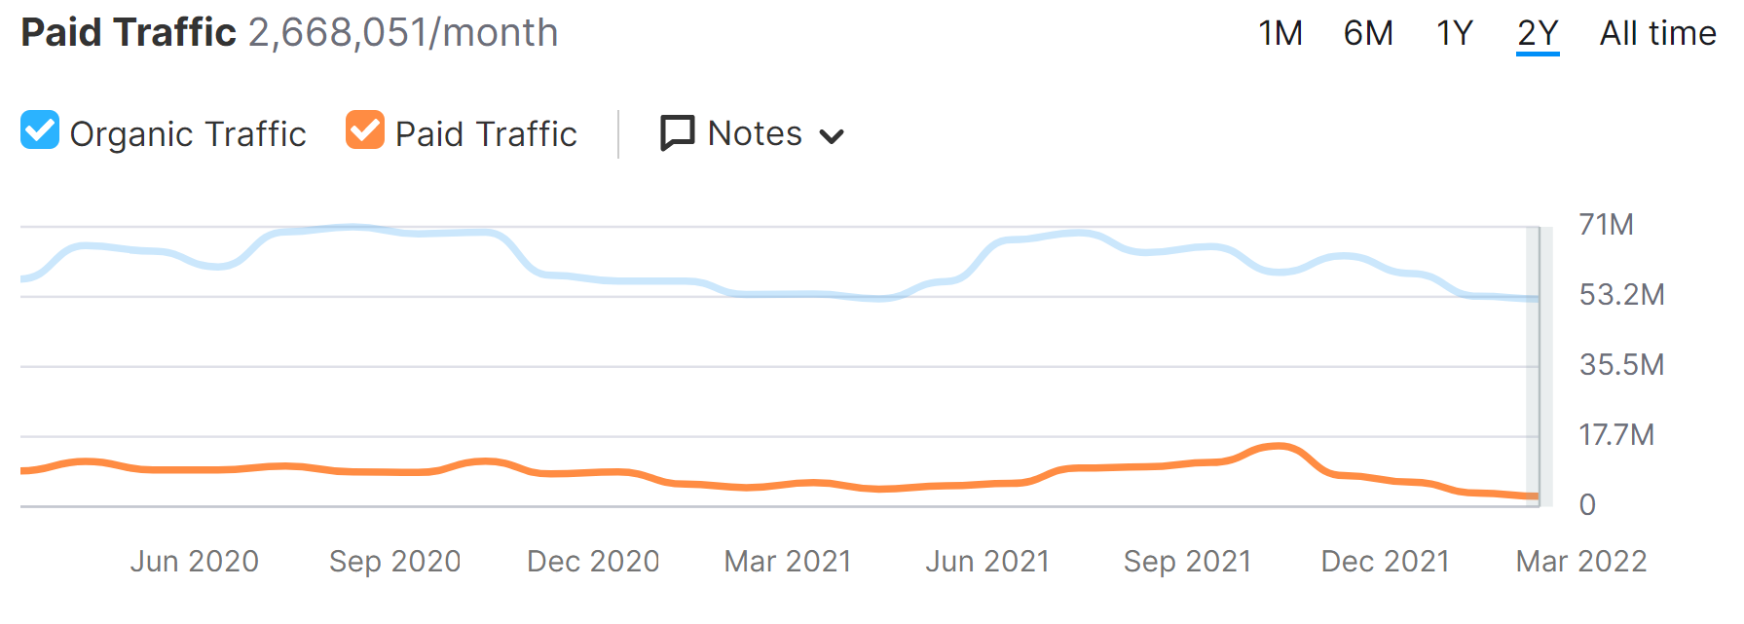
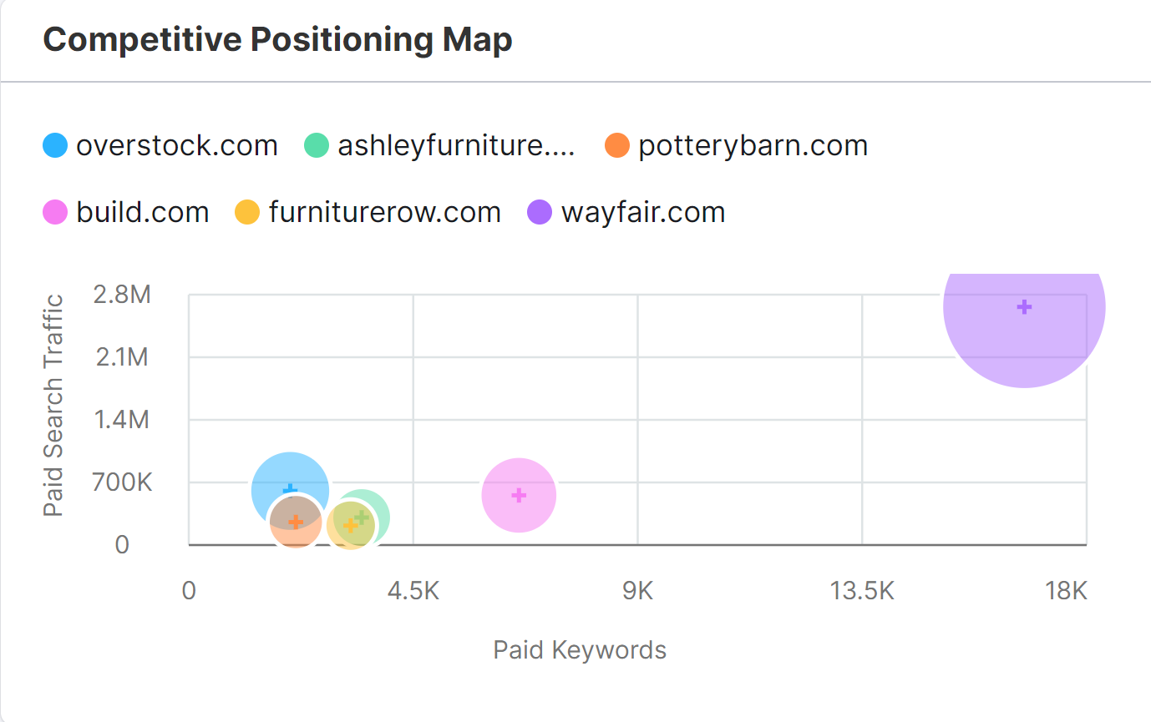
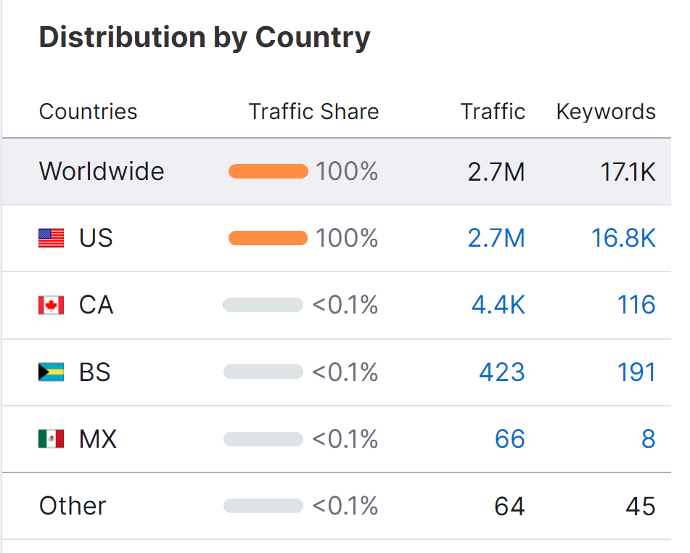
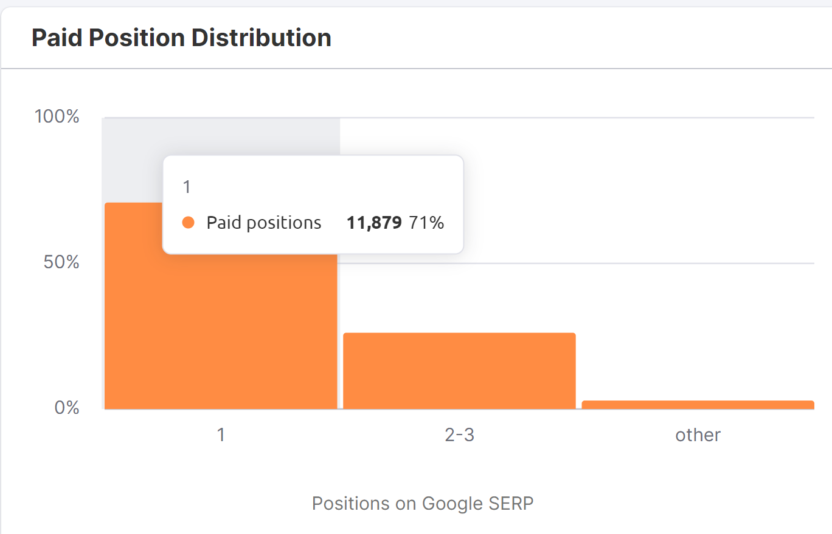
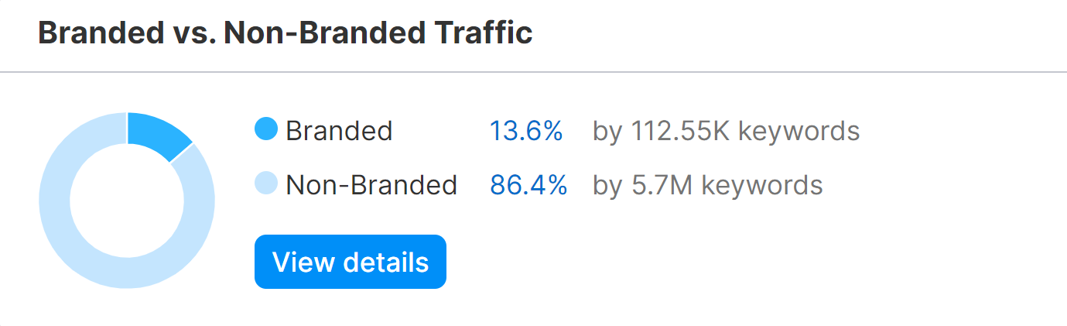
Search Engine Marketing - Paid
Stats of the Paid distribution in US – 17.1K keywords are focused mostly category keywords
The paid traffic is 2.7 Mn that is pretty good. Shows, Wayfair is spending good amount of money on SEM
Wayfair is performing pretty decent among a few competitors.
Rank 1 keywords are related to category for example: best tables
As per my analysis, focusing maximum on category keywords

Slide 17
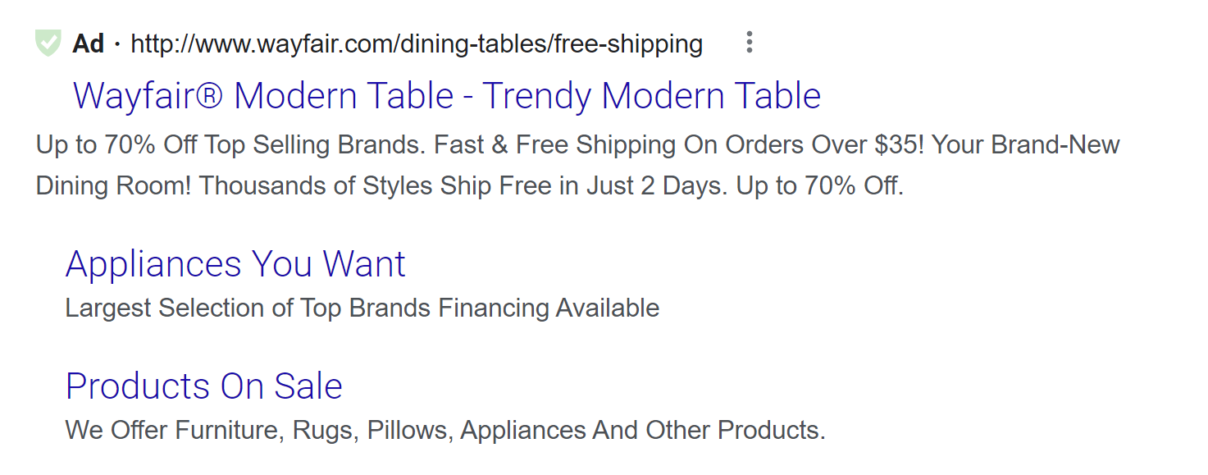
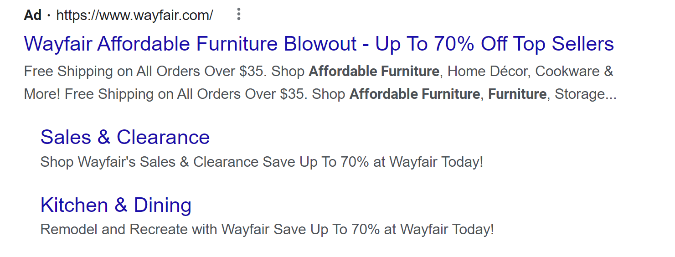
SEM Strategy - Paid
The current strategy is brilliant when it comes to SEM.
Whatever product one types on google the first ad placement is of Wayfair
Talking about the Ads – The description, Headline and ad copy are perfect.
As brand and category keyword strategy is perfect. The only improvement needs to be done on Competition keywords.
Focus should be on words like:
A) Amazon Furniture
B) Bob’s furniture
C) Ikea discounted products
D) Ashley home furniture
*Definitely competition keywords will have very high bid but experimenting would give good insights

Slide 18
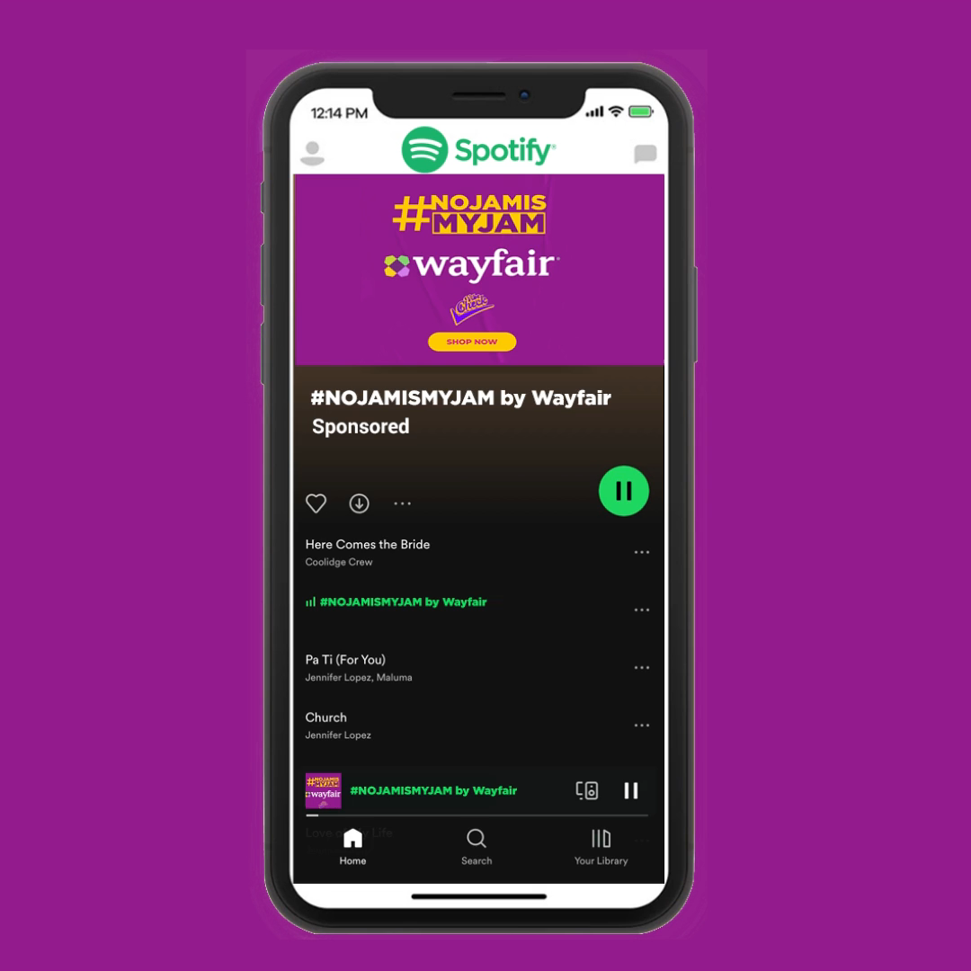
Spotify Ads - Paid
Please press play to hear the ad
HEAR THE AD
Gen Z loves music and listens to them on popular platforms like, Spotify. Wayfair ties up with one such popular music streaming platform and puts contextual audio based ads that match the genre of the music.
Ad Transcript: Stuck in a jam-packed home with boring furniture, sucks.
That’s about to change.
Cut the clutter.
With Wayfair
Stylish,
Chic,
Pocket Friendly
And
Functional furniture
Cause no jam is my jam

Slide 19
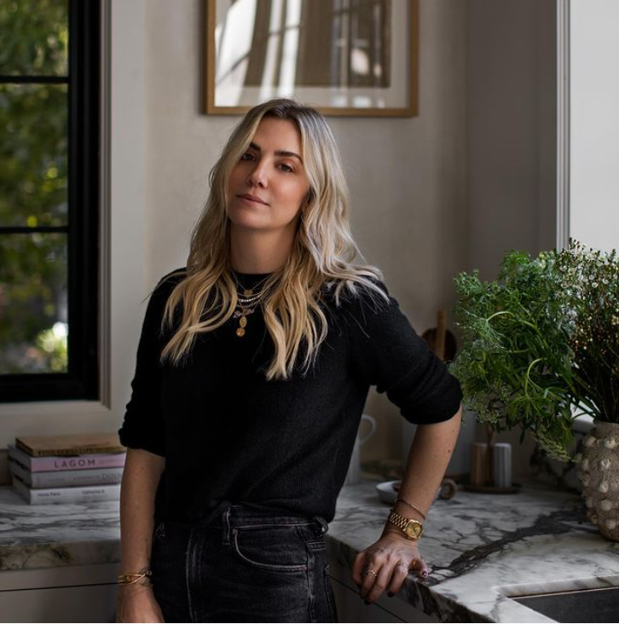
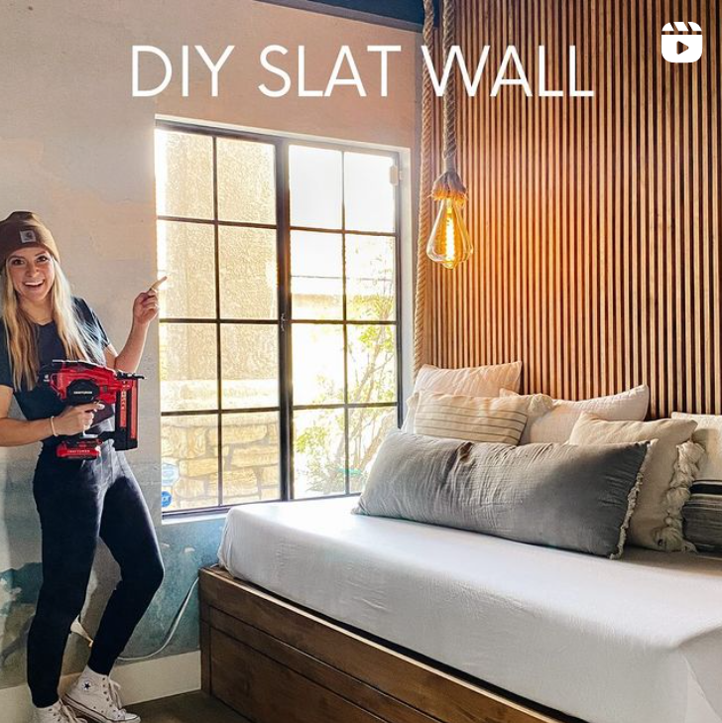
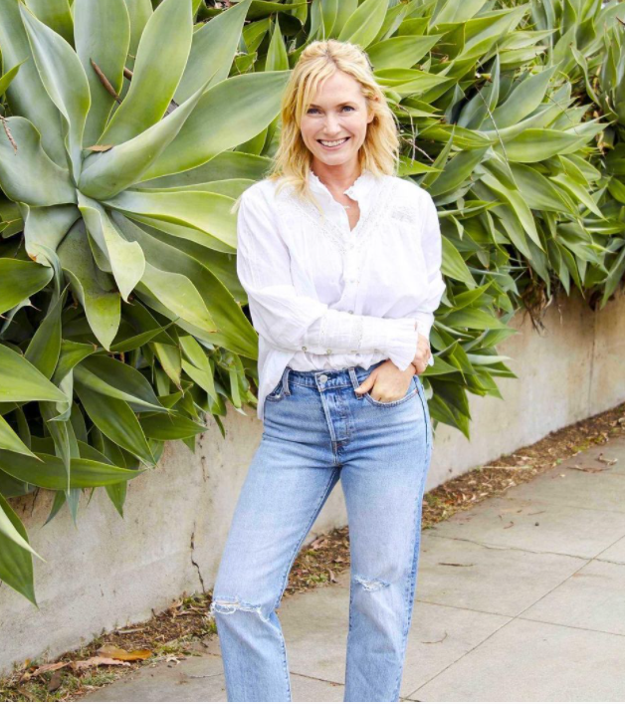
Influencer Marketing-Earned
Amber Lewis
Handle: amberinteriors
Angela Rose
Handle: angelarosehomes
These influencers aka interior designers will give DIY hacks in videos to decorate home with Wayfair Products. Even dos and don’ts of furniture while buying online
Emily Henderson
em_henderson

Slide 20
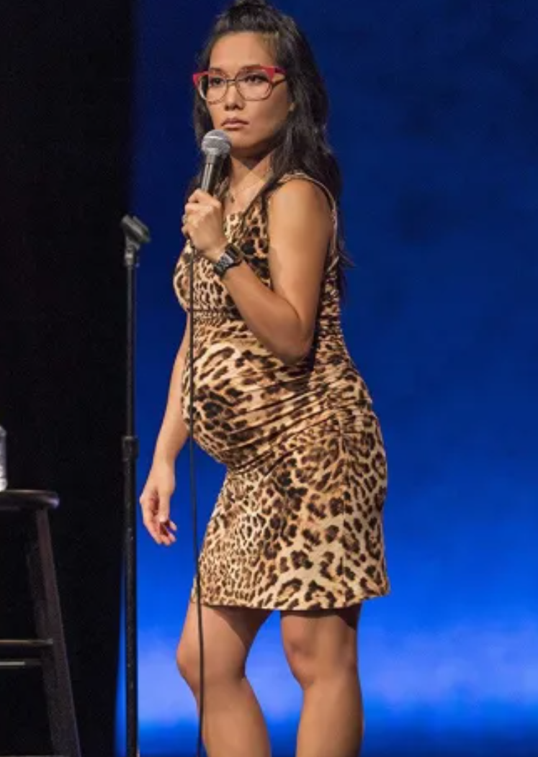

Comedy Events - Earned
JAM FREE NIGHTS WITH ALI WONG/JOE MANDE
Collaborate with comedians to perform jokes on people’s taste on home designs, awful tastes to classy ones thereby cleverly integrating product USPs. After the show an experiential tour to view the quality of the products sold on Wayfair.

Slide 21
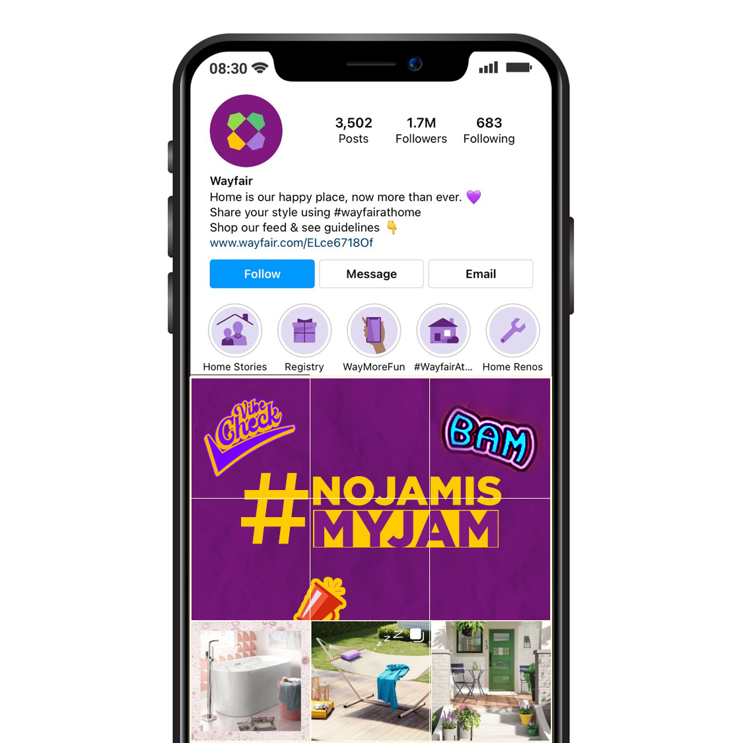
Instagram Posts - Shared
Highlighting the Campaign Concept through engaging and visually good posts.

Slide 22
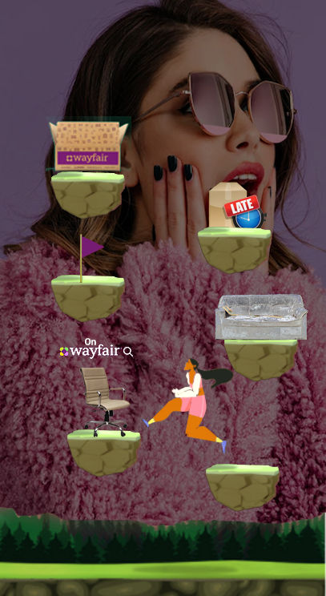
Instagram Stories - Shared
INSTAGRAM STORY x AR FILTER GAME
Fun and easy Instagram game. People need to move their heads to surf through the obstacles such as broken sofa or late delivery.
Users need to earn more points by reaching Wayfair’s USPs, features, deals, furniture, etc.
After every wrong move such as late delivery a pop up banner will appear highlighting exclusive benefits of Wayfair and how these issues with this brand can be resolved.

Slide 23
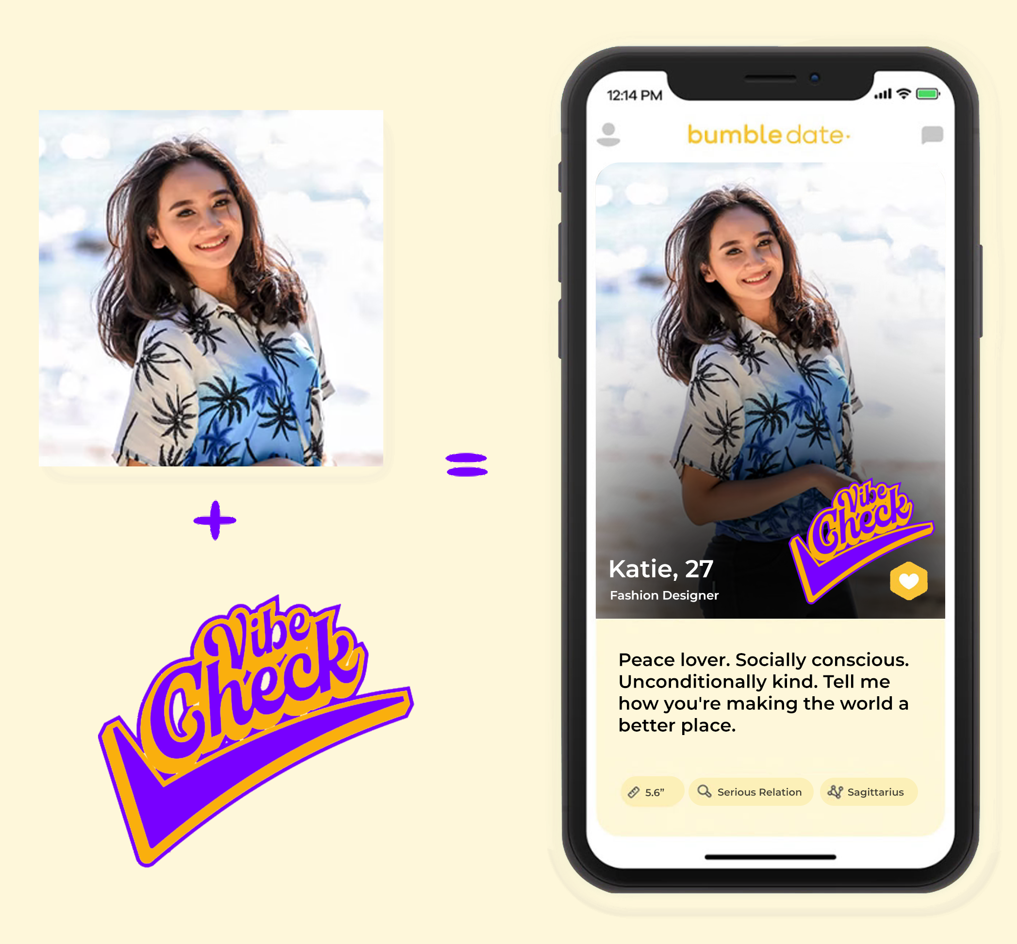

Bumble- Shared
BUMBLE x VIBE CHECK BADGE
Introduce a Vibe Check community on Bumble. This badge will appear on anyone’s profiles, subtly informing the creeps on dating apps to not mess with the vibe check people. To unlock this badge, people will have to fill a form, tell what is their style for decorating home and what more they expect from wayfair to do better with their email ID and become a part of the tribe.

Slide 24
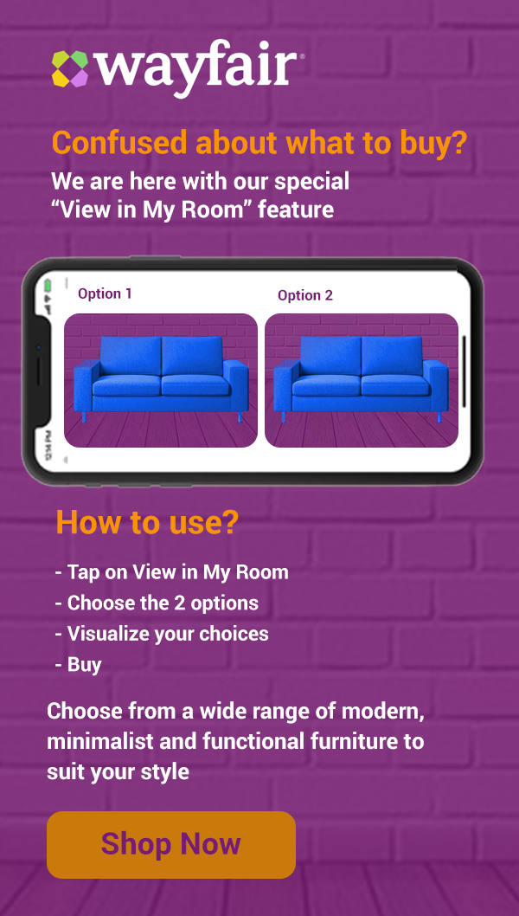
Email Marketing and SMS Marketing - Owned
Target the existing customers as well as new users by showing amazing features and value propositions of Wayfair.
Educate them with guided tour/writing steps and guidance for understanding the feature
Highlighting amazing offers and collections via SMS in a personalized way for direct conversion

Slide 25
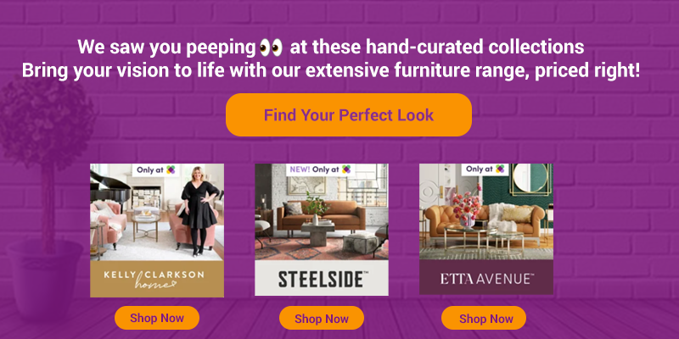
Push Notifications - Owned
Target the existing customers as well as new users by personalizing their journey at every touch point.
It is well-know that the CTRs of image push notifications are better than text push notifications. So, wayfair should try more image based notifications with the new feasibility of clicks at multiple areas. Hence, more than one CTA and different redirection links
Multiple Click feasibility enhancement

Slide 26
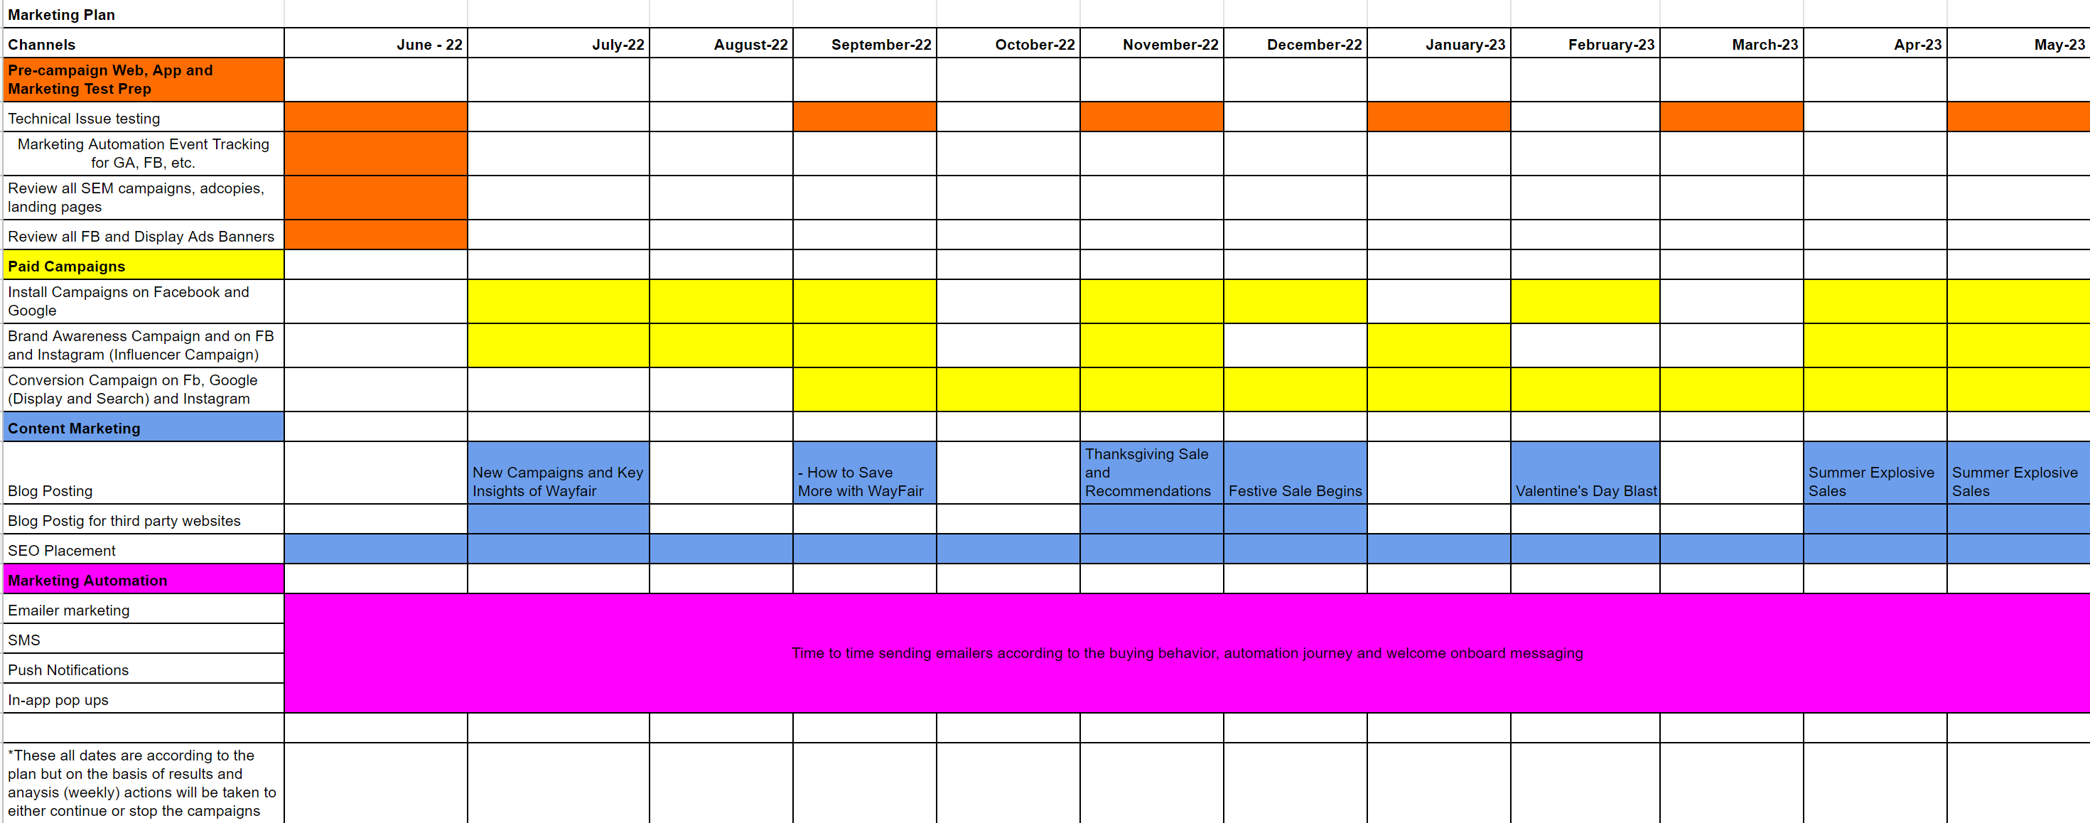
ROLL OUT TIMING PLAN

